Slide 1

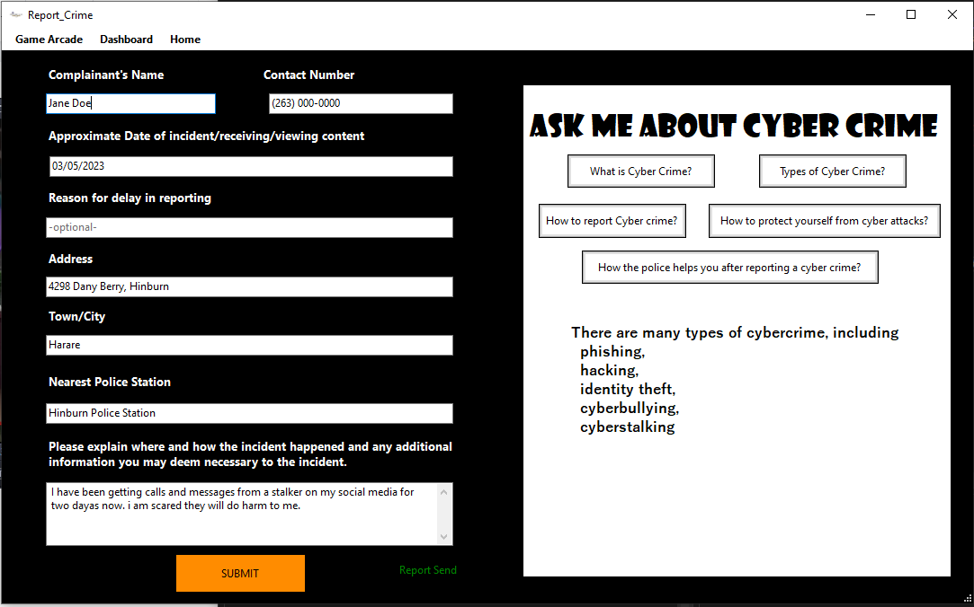
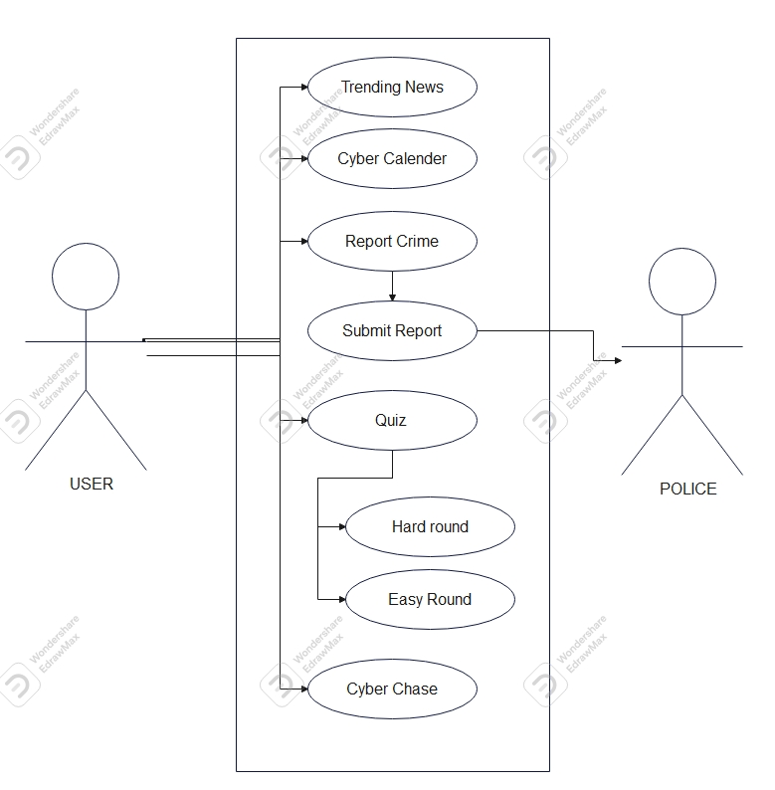
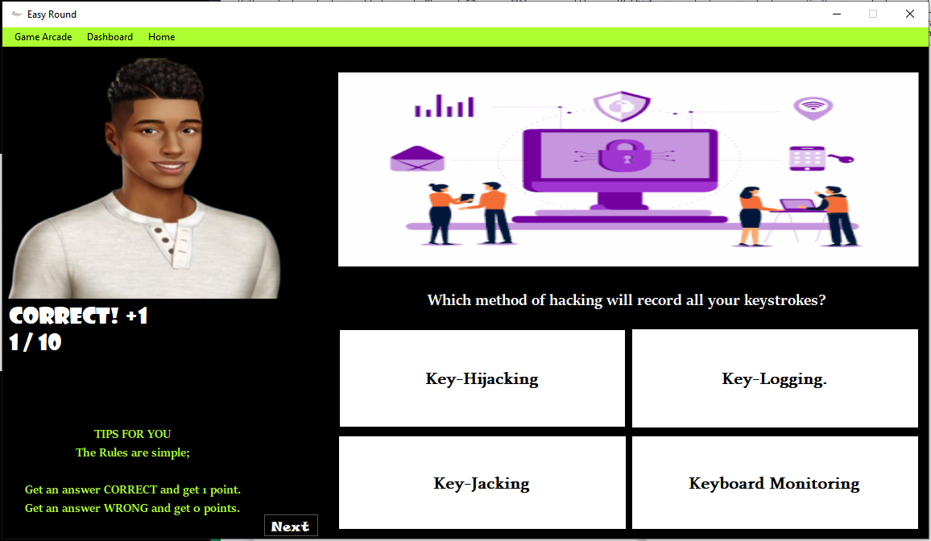
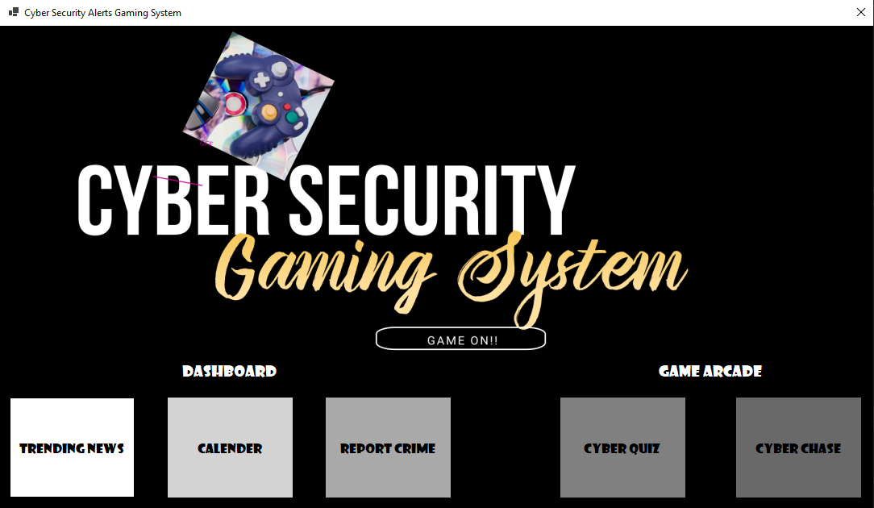
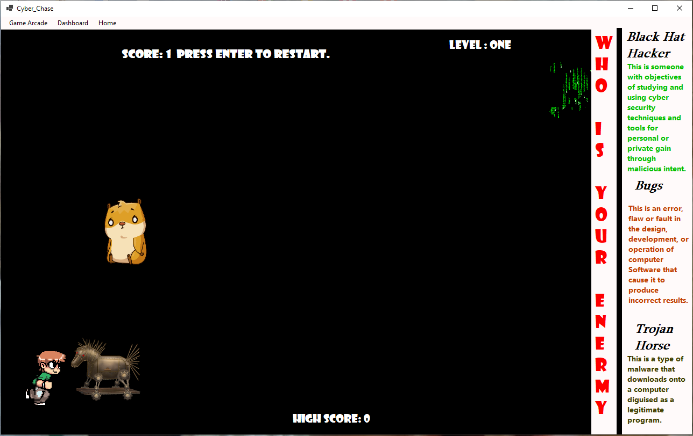
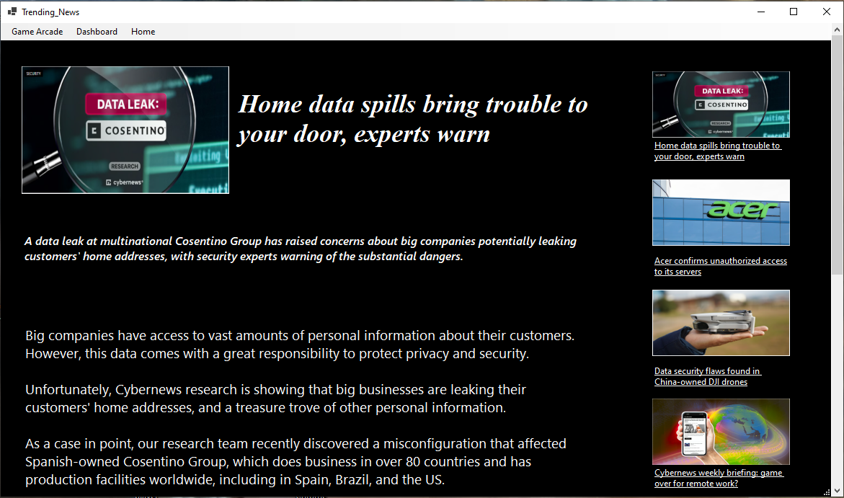
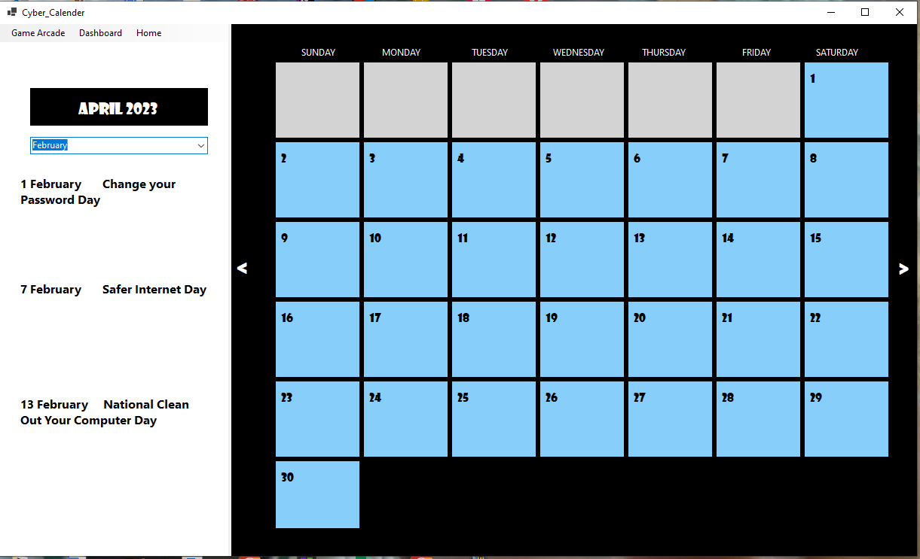
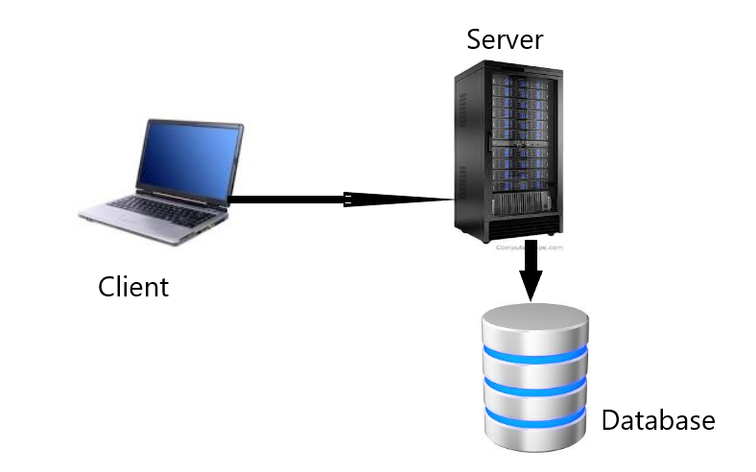
CYBER SECURITY GAMING SYSTEM
Isheanesu Vunganai - Software Engineering Department
1.0 Abstract
3.0. Problem definition
7.0. Use Case Diagram
Zimbabwe is a developing country that is still growing in terms of technology at a faster pace, but, the bigger the influence of technology, the bigger the Cyber Space, and the greater the Cyber Risk and Crime. Thus, the need for a Cyber Space Control measure. Cyber Security is an immediate online system that links cyber security reports to the authority that can help Zimbabwean people who are exposed to Cyber Crime but at the same time creating a fun learning experience for its users regardless of age. The Cyber Security Gaming System is a software system that allows a user to play educational game(s) about the cyberspace and at the same time act as a platform where users can submit a report of cyber-crime done to them or a colleague. It is also a system that spreads awareness of the cyberspace, cyber crime and cyber security through news and a calendar of future cyber security events.
The problems faced by Zimbabweans are; the fast-paced growth of Cyber crime, especially Scams and Phishing, and the lack of knowledge about Cyber Space, Cyber Crime, and Cyber Security.
Zimbabwe has a lot of learned people and fast-growing technology but so is the growth and widespread of Cyber-crime. Zimbabweans have been mostly exposed to scams and phishing schemes due to their country’s economy, that cyber criminals have seen this as a chance to lure and entice Zimbabwe. Zimbabwean citizens also lack enough knowledge of Cyber Space and its risks to users. They do not have enough information on how to protect themselves and prevent cyber-criminals from taking advantage of them. The gap between the level at which technology is influencing Zimbabwe and the level at which Zimbabweans know how to protect themselves is only growing by the minute.
2.0. Introduction
4.0. Overview of the developed application
The developed web land audit system allows Local Authority technicians to allocate land parcels on the system and in real-time these allocations reflect in the Ministry of local government database, thus ensuring real time monitoring of land distribution in all local authorities in the country.
Each of these elements requires a unique data-collection methodology that includes spatial data collection; aerial photography and mapping of property boundaries.
The system will be showing allocated and unallocated land parcels in all local authorities in the country as well as the different uses of the allocated land.
8.0. Screenshots
Zimbabwe is a developing country that is still growing in terms of technology at a faster pace, but, the bigger the influence of technology, the bigger the Cyber Space, and the greater the Cyber Risk and Crime. Thus, the need for a Cyber Space Control measure. Cyber Security is an immediate online system that links cyber security reports to the authority that can help Zimbabwean people who are exposed to Cyber Crime but at the same time creating a fun learning experience for its users regardless of age. This platform allows people to air their Cyber Security ideas, experiences, and get education.
The goal of the project and main focused objectives of the Cyber Security system are;
-To create two games that are fun and interesting in a way to educate Zimbabweans on the Cyberspace, its risks and securities. these games being:
•Quiz Game
•Cyber Chace
-To have windows that promote awareness of the Cyber space, crime and security by:
•Showing recent news about the Cyberspace (Trending News)
•Showing recent and future Cyber Security events (Cyber Calender)
-To provide a button to submit reports of cases of cyber-crimes to the Zimbabwe Republic Police.
The implementation of this gaming system will be expected to shine on what can be done to best educate and protect Zimbabweans from cyber risks that are thriving on the cyberspace and on their lack of knowledge. The Design and content of serious games affect learners’ potential to form knowledge, skills and Habitual patterns [1]. This system will be a way out for many Zimbabweans to be educated, protected and protect themselves on the cyberspace, as this system will work as a way for Zimbabweans to learn and at the same time have fun.
5.0. Objectives
To create two games that are fun and interesting in a way to educate Zimbabweans on the Cyberspace, its risks and securities. these games being: Quiz Game, Cyber Chace
To have windows that promote awareness of the Cyber space, crime and security by:
•Showing recent news about the Cyberspace (Trending News)
•Showing recent and future Cyber Security events (Cyber Calender)
To provide a button to submit reports of cases of cyber-crimes to the Zimbabwe Republic Police.
Conclusion
The system managed to meet all of its objectives. As mentioned in the previous chapters, the system enables local authority technicians to allocate land parcels, the system allows Local government Ministry auditors to remotely monitor the distribution of land in all local authorities across the country. Also the system shows a land summary report showing total allocated land parcels, total unallocated land parcels and the total sum of land parcels in a region. The system enables both Local government auditors and Local authority technicians to search for land parcels using land parcel account number.
6.0. System Overview
Supervisor –W. S. Manjoro

